Slide 1
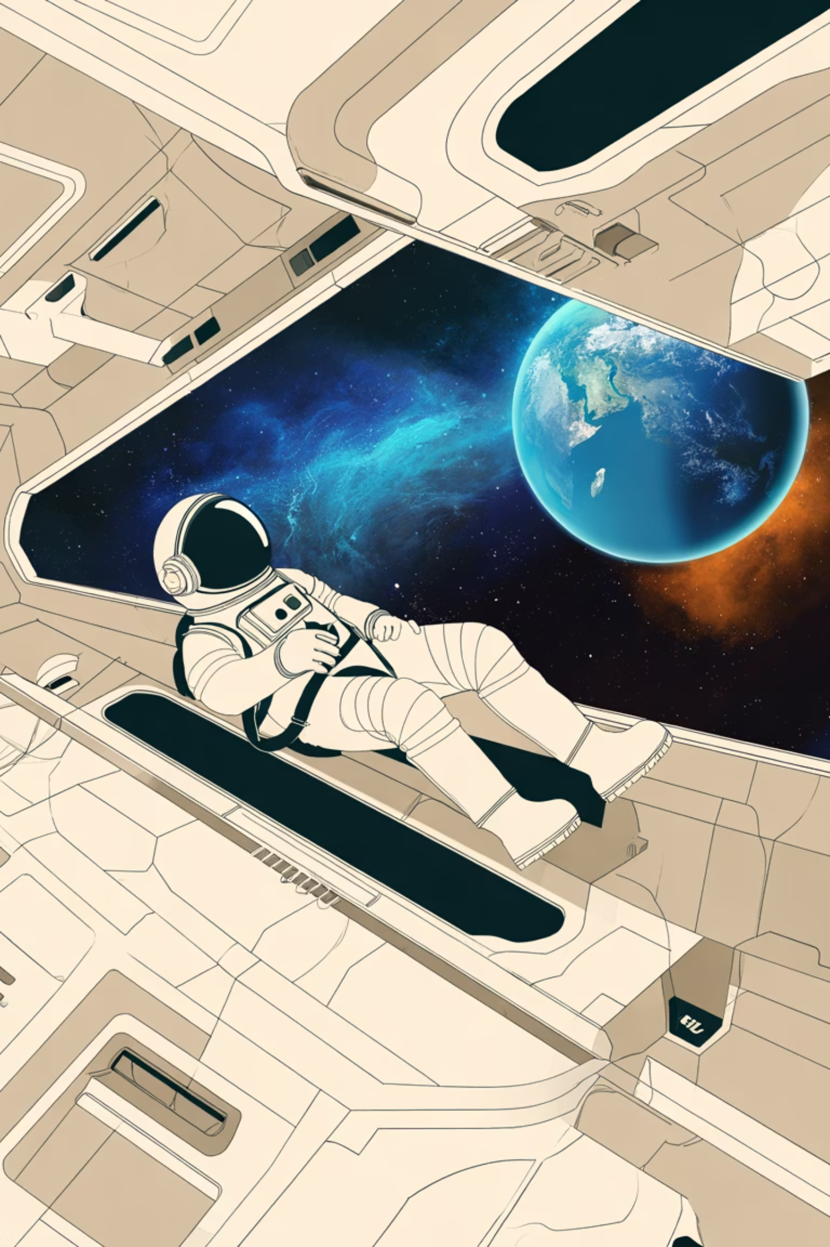

CosmoGuide AI: Your Ultimate Space SOS & Exploration Partner
Innovation Beyond Earth

Slide 2
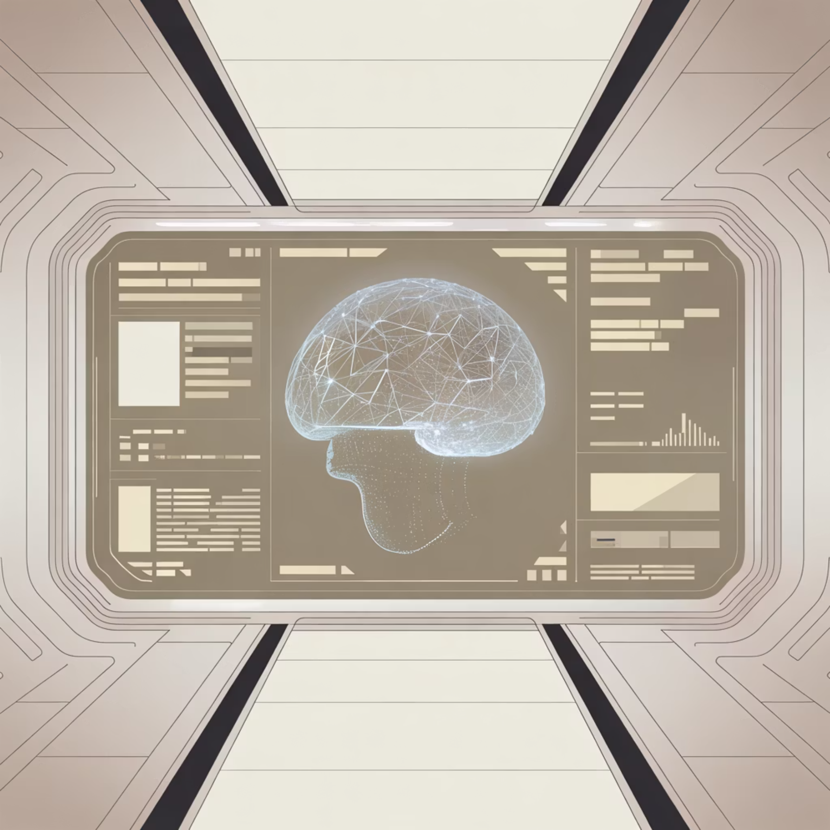
Redefining Safety in the Final Frontier
Our Mission
CosmoGuide AI represents a quantum leap in space exploration technology—an intelligent companion system designed to protect and empower astronauts during critical missions beyond Earth's orbit.
By harnessing advanced artificial intelligence, real-time diagnostics, and predictive analytics, we're creating a guardian angel for humanity's boldest journeys into the cosmos.

Slide 3

Inspired by Visionaries Who Dare to Dream
Narendra Modi's Vision
Elon Musk's Ambition
Bill Gates' Philosophy
"Innovation for humanity's progress—technology that serves every individual, from Earth to the stars."
"Making life multi-planetary through relentless innovation in space exploration and artificial intelligence."
"Leveraging technology for global betterment—creating systems that enhance human capability and safety."
CosmoGuide AI embodies these principles: innovation that transcends boundaries, courage to explore the unknown, and intelligence that safeguards human life.

Slide 4
Core Intelligence: Five Pillars of Protection
01
02
03
Emergency SOS & Diagnostics
Health Monitoring & Life-Support Alerts
Real-Time Communication Aid
Instant threat detection, automated distress signals, and intelligent troubleshooting for critical system failures
Continuous biometric tracking with AI-powered health predictions and life-support system optimization
Advanced signal processing that maintains Earth connectivity even during communication blackouts
04
05
Mission Analytics & Navigation Guidance
Predictive AI for Risk Management
Precision trajectory calculations, resource management, and adaptive mission planning
Machine learning algorithms that anticipate dangers before they materialize, ensuring proactive safety

Slide 5
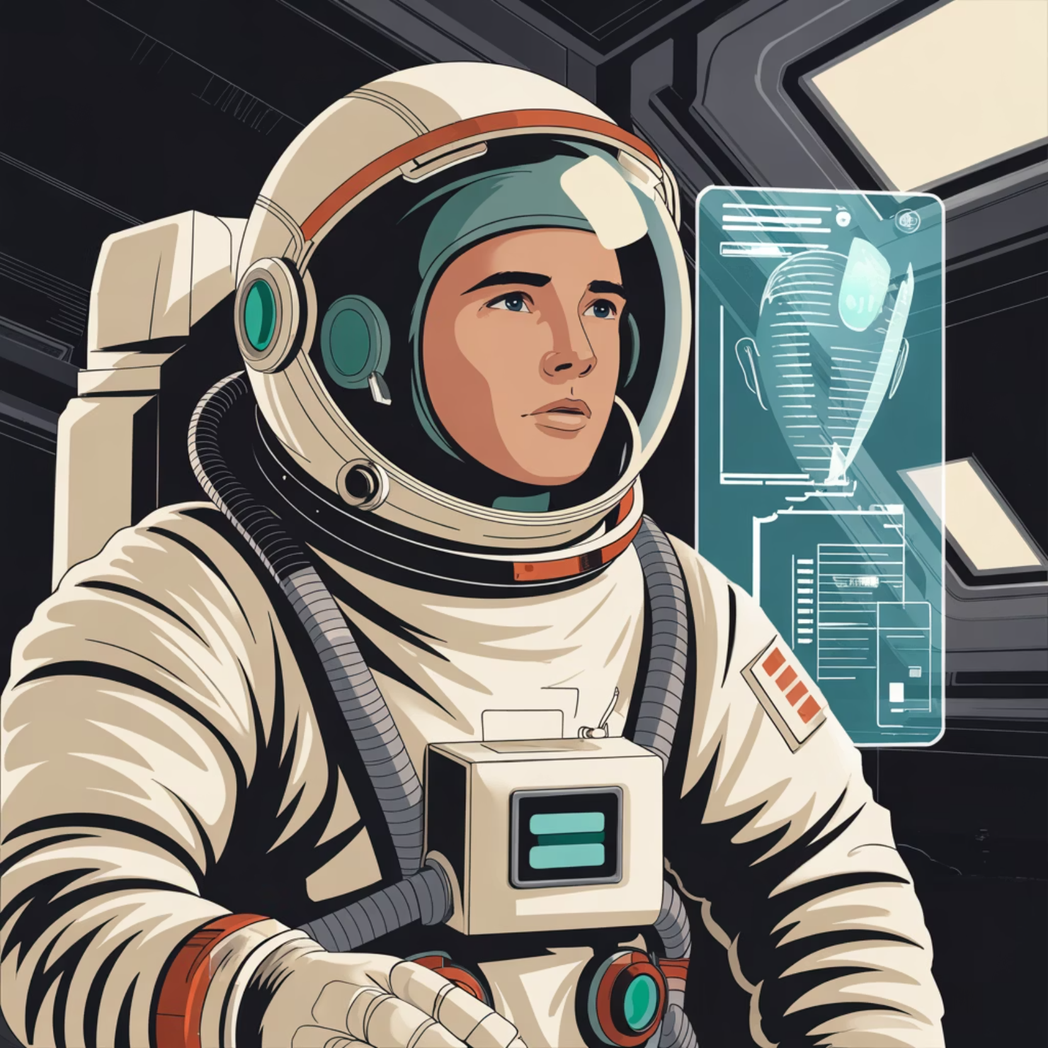
Emergency Response in Action
When Every Second Counts
In the unforgiving environment of space, CosmoGuide AI acts as your first responder. The system detects anomalies in milliseconds, from oxygen leaks to equipment malfunctions.
Automated protocols activate immediately, while simultaneous alerts reach mission control with comprehensive diagnostic data. The AI doesn't just identify problems—it provides solutions, drawing from vast databases of space emergency procedures and real-time system analysis.

Slide 6
Revolutionary Technology Stack
Advanced AI & Machine Learning
Natural Language Processing
Neural networks trained on decades of space mission data, capable of learning and adapting to unprecedented situations in real-time.
Intuitive voice-command interface enabling hands-free operation during critical moments when manual control isn't possible.
IoT Integration & Sensors
Quantum-Speed Data Analysis
Seamless connectivity with every spacecraft system—from life support to propulsion—creating a unified intelligence network.
Processing terabytes of telemetry data instantaneously to identify patterns, predict failures, and optimize mission performance.

Slide 7




Transforming Future Space Missions
Enhanced Safety Protocols
Operational Excellence
Mission Success Rate
Reducing mission risk by 73% through predictive analytics and automated emergency response systems
Streamlining crew workload with intelligent automation, allowing focus on exploration and discovery
Maximizing achievement of scientific objectives through optimized resource management and adaptive planning
CosmoGuide AI doesn't just support missions—it revolutionizes what's possible. By removing the cognitive burden of constant system monitoring, astronauts can dedicate their expertise to scientific discovery and exploration.

Slide 8
Impact Across the Space Exploration Ecosystem
85%
24/7
100+
40%
Faster Response
Continuous Guardian
Mission Parameters
Resource Efficiency
Emergency detection and response time compared to manual monitoring systems
Simultaneous tracking of critical indicators from life support to navigation
Improvement in fuel, oxygen, and supply management through AI optimization
Unwavering vigilance monitoring all spacecraft systems simultaneously

Slide 9
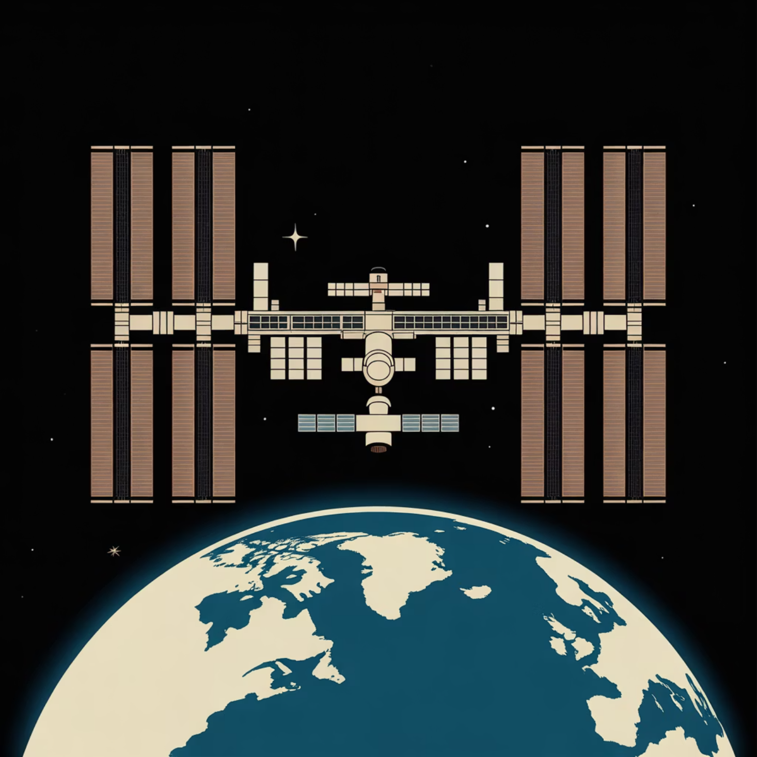
Uniting Nations Through Innovation
Global Collaboration for Cosmic Exploration
CosmoGuide AI transcends borders, serving as a universal platform for international space agencies, private aerospace companies, and research institutions worldwide.
By establishing common safety protocols and shared intelligence systems, we're fostering unprecedented cooperation in humanity's journey to the stars. Every mission strengthens our collective knowledge, every challenge overcome benefits all explorers.
This is more than technology—it's a testament to what humanity can achieve when we work together toward a common vision of exploration, discovery, and survival beyond Earth.

Slide 10

Where Innovation, Courage, and Intelligence Unite to Explore the Infinite
CosmoGuide AI represents humanity's commitment to safe, intelligent, and ambitious space exploration. As we venture deeper into the cosmos, this guardian system ensures that every astronaut has the support, protection, and intelligence needed to return home safely—while pushing the boundaries of what's possible.
Developed with Vision and Excellence
GD Goenka Public School, Rohini Sector 9
Pioneering Innovation for Tomorrow's Space Explorers

